Slide 1
Clustering Countries for Targeted Socio-Economic and Health Interventions
Aniruddha Joshi

Slide 2
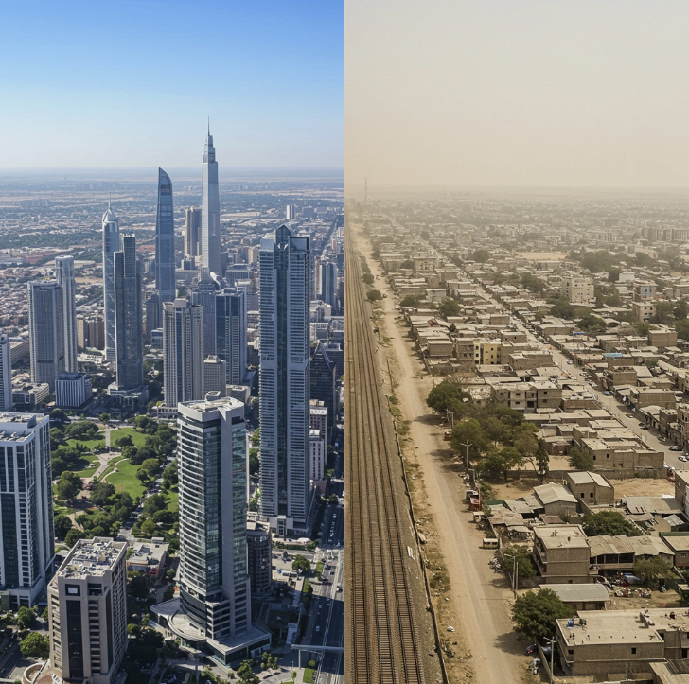
Business Problem
Many countries face socio-economic and health challenges.
Limited resources require a focused approach to development and aid.
Categorizing countries based on key indicators allows for identifying specific needs.
Prioritize interventions in areas like infrastructure, health, and education.

Slide 3
Understanding the data
Dataset: Unsupervised Learning on Country Data from Kaggle :
https://www.kaggle.com/datasets/rohan0301/unsupervised-learning-on-country-data/data
Size: Around 167 records
Variables:
Child
mortality
Exports
Health
Imports
Income
Inflation
Life expectancy
Total fertility
GDP per capita

Slide 4
Cleaning and Processing the data
Libraries Used: Pandas and NumPy
Steps Followed:
Removing invalid or incomplete rows
Filling missing data with mean values
Converting categorical data to one-hot encoding
Ensuring appropriate data types
Dropping rows with NA values
Column | Total Count | Missing Count | Missing (%) | NA Count | NA (%) | Data Type | Unique Values | Outlier Count | Minimum | Maximum | Skewness
country | 167 | 0 | 0.0 | 0 | 0.0 | category | 167 | NaN | NaN | NaN | NaN
child_mort | 167 | 0 | 0.0 | 0 | 0.0 | float64 | 139 | 4.0 | 2.6000 | 208.00 | 1.450774
exports | 167 | 0 | 0.0 | 0 | 0.0 | float64 | 147 | 5.0 | 0.1090 | 200.00 | 2.445824
health | 167 | 0 | 0.0 | 0 | 0.0 | float64 | 147 | 2.0 | 1.8100 | 17.90 | 0.705746
imports | 167 | 0 | 0.0 | 0 | 0.0 | float64 | 151 | 4.0 | 0.0659 | 174.00 | 1.905276
income | 167 | 0 | 0.0 | 0 | 0.0 | float64 | 156 | 8.0 | 609.0000 | 125000.00 | 2.231480
inflation | 167 | 0 | 0.0 | 0 | 0.0 | float64 | 156 | 5.0 | -4.2100 | 104.00 | 5.154049
life_expec | 167 | 0 | 0.0 | 0 | 0.0 | float64 | 127 | 3.0 | 32.1000 | 82.80 | -0.970996
total_fer | 167 | 0 | 0.0 | 0 | 0.0 | float64 | 138 | 1.0 | 1.1500 | 7.49 | 0.967092
gdpp | 167 | 0 | 0.0 | 0 | 0.0 | float64 | 157 | 25.0 | 231.0000 | 105000.00 | 2.218051

Slide 5
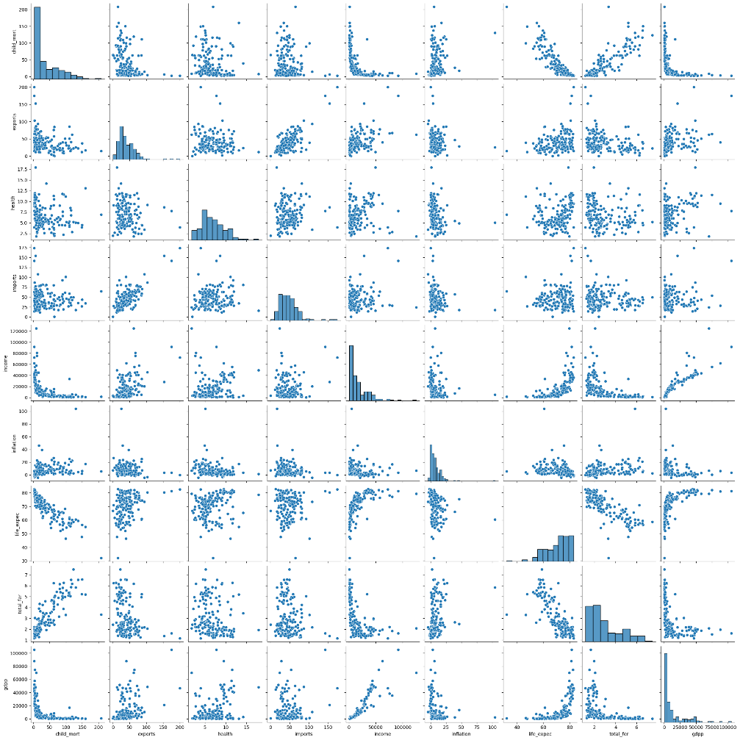
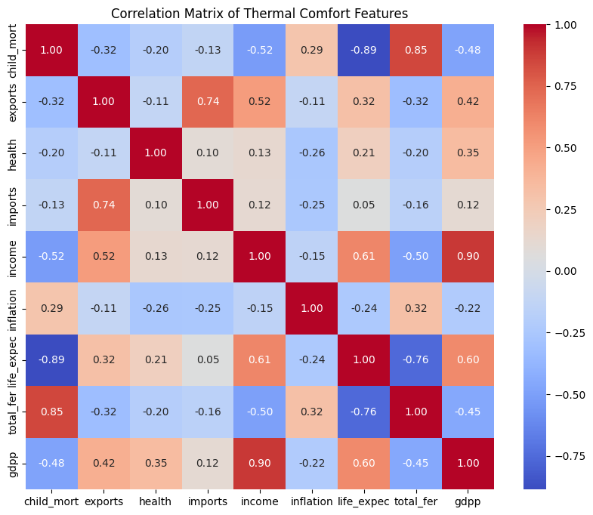
Visualizing the data

Slide 6
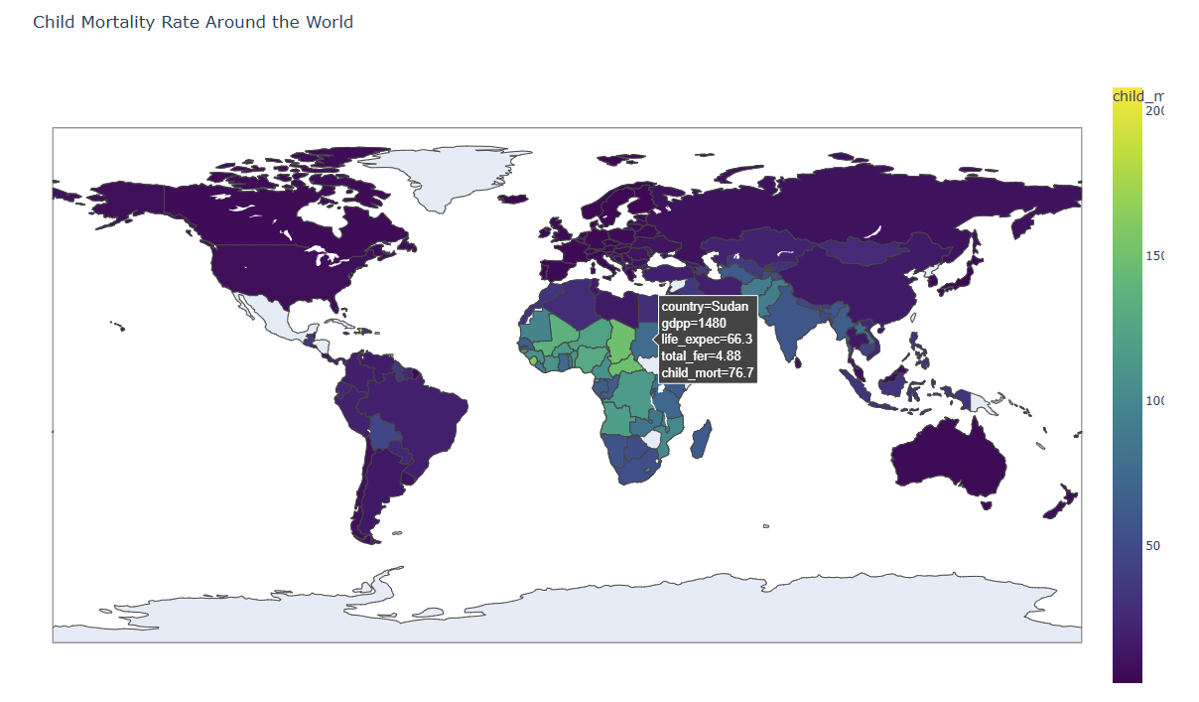
Visualizing the data

Slide 7
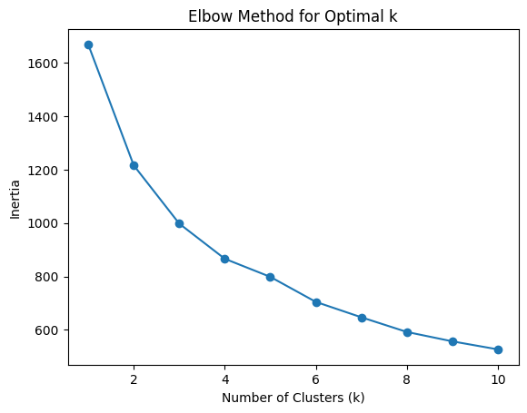
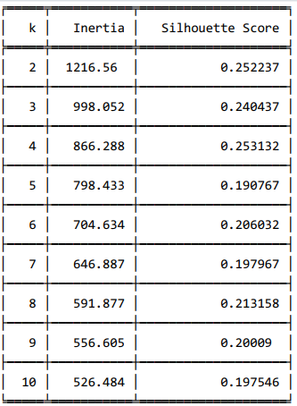
Applying Machine Learning
Silhouette Score
K=4 Selected

Slide 8
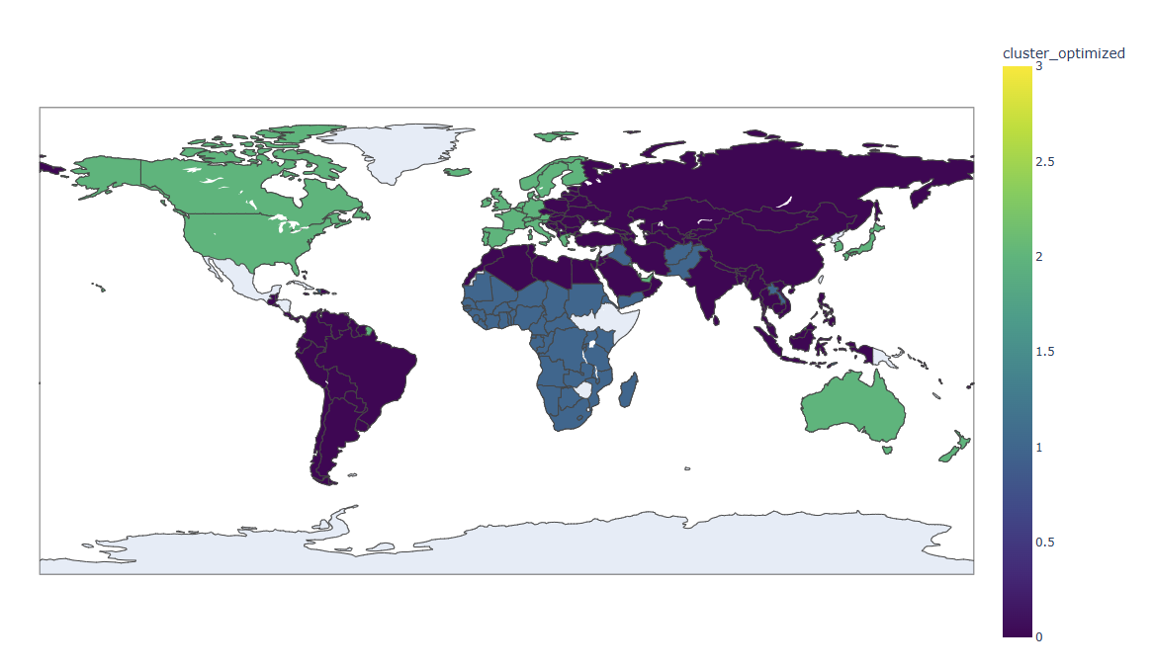
Targeted Investment
With K=4, Effective grouping of countries with similar characteristics
Asia and South America show a need for more funding

Slide 9
Future Work and Ethical Consideration
Expanding the dataset with more countries and variables
Applying the model to other datasets
Adapting the model for sub-national clustering

